Slide 1


Mobile Application Development
A.Y. 2025-2026
NutriLens
Scan, explore, decide — every product, the right choice for you.
Valentina Debbia - 74280A

Slide 2


THE PROBLEM
It's not an education issue, it's a design problem. Labels are packed with technical jargon, printed in tiny font, and built for compliance, not communication.
6 OUT OF 10 PEOPLE WORLWIDE
do not understand food labels
Nielsen, 2011
For those with allergies, intolerances, or specific dietary needs, every wrong purchase is a potential health hazard.

Slide 3
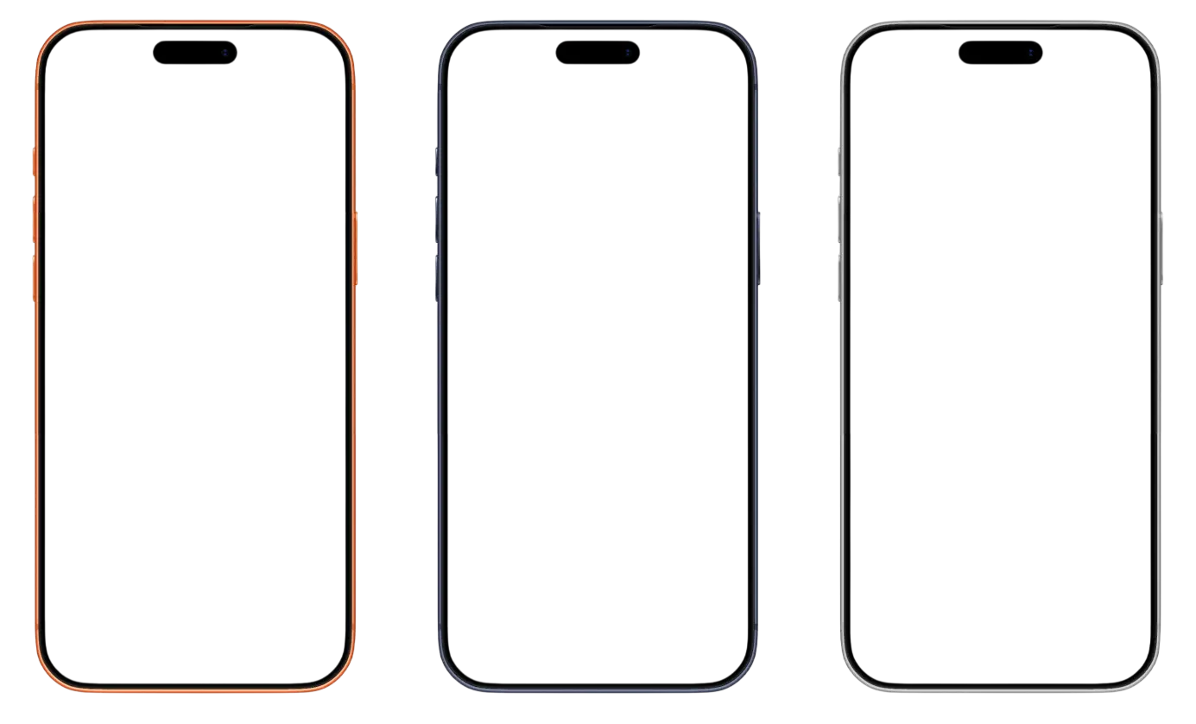
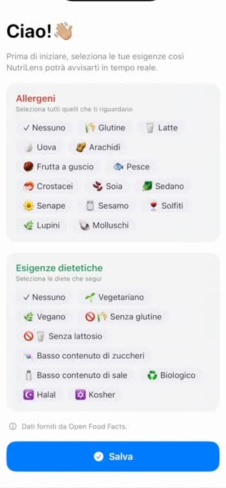
THE SOLUTION
NutriLens
- an iOS app that transforms your smartphone into an intelligent nutrition assistant
By framing a product through the camera, the user receives instant multisensory feedback (color‑coded, auditory, and haptic) about its compatibility with their dietary profile.
By long‑pressing anywhere on the screen, an Augmented Reality info card appears and, with a single tap, rotates to reveal all relevant details.
At the center of the entire system lies the user profile: 14 EU‑mandated allergens plus 9 configurable dietary requirements.

Slide 4
THE POSSIBLE SCENARIOS
DANGER STATE
WARNING STATE
COMPATIBLE STATE
Highlights any forbidden allergens or dietary profiles for which the product is unsuitable.
  EU‑declared allergens present in the product and/or unmet dietary requirements
  intense haptic feedback paired with an alert soundfeedback
Signals the presence of potentially risky allergen traces within the product.
  declared traces of EU‑regulated allergens present in the product
  moderate alert to support an informed choice
Confirms that the product is fully compatible and reveals its complete nutritional profile.
  no relevant allergens or traces detected, and all dietary requirements are fully met
  confirmation alert with detailed corresponding nutritional values

Slide 5




HOW DOES IT WORK
ARKit
Riconoscimento
Valutazione
  detects in real time the physical marker printed on the product’s packaging
  the app searches for the corresponding product in its local database
  the system automatically compares the product’s allergens, traces, and dietary requirements with the user’s configured preferences, and computes a safety state
Input
the system leverages the user’s configured profile
  the result is communicated instantly through the AR card anchored to the object, accompanied by a sound and a haptic feedback
Output
The entire pipeline runs on‑device, with no calls to external servers: zero latency, zero dependence on connectivity.

Slide 6
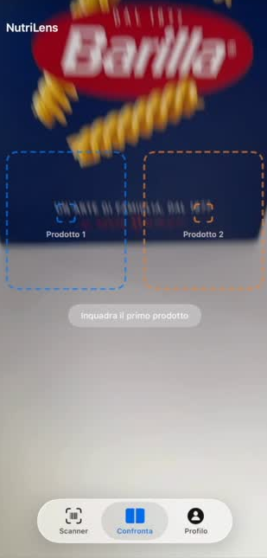
FOOD COMPARISON
NutriLens
- extends beyond individual products, enabling a direct comparison between two food items
The app generates two side‑by‑side AR cards. If either product contains allergens, traces, or does not meet the user’s dietary requirements, it is immediately ‘rejected’ visually, guiding the user toward the safe alternative.
If both products satisfy the user’s constraints, the app activates a Nutri‑Score–based comparison algorithm. An intuitive graphical indicator highlights the item with the superior nutritional profile.

Slide 7
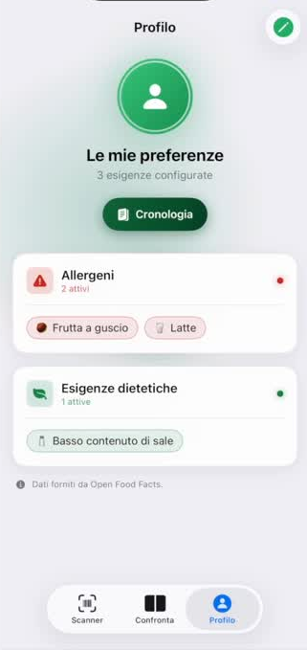
PROFILE
NutriLens
- it also includes a dedicated user section, offering two distinct yet complementary functions
PROFILE
The profile is set once but can be modified at any time; it is designed for users who later discover a new intolerance or simply change their diet.
CHRONOLOGY
Every scanned product is saved automatically and treated like a collectible card, viewable inside a 3D Augmented Reality album.

Slide 8
Thank you for your attention

